Slide 1
Employee Data Analysis using Excel
STUDENT NAME: HEMAVATHI N
REGISTER NO:CF882F617C9A5A8BC8A4E0B3EEF4625C,312208682
DEPARTMENT:B.COM[GENERAL]
COLLEGE:MEENAKSHI COLLEGE FOR WOMEN

Slide 2
PROJECT TITLE
Employee Performance Analysis
Based On Departments, Employee
Type And FTE using Excel

Slide 3


AGENDA
Problem Statement
Project Overview
End Users
Our Solution and Proposition
Dataset Description
Modelling Approach
Results and Discussion
Conclusion
3/21/2024 Annual Review

Slide 4

PROBLEM STATEMENT
The purpose of Full-Time Equivalent
(FTE) is to standardize the
measurement of employee work hours,
regardless of whether they work
full-time or part-time, in order to
better manage, allocate, and analyze
workforce resources.

Slide 5

PROJECT OVERVIEW
Employee analytics, also known as workforce analytics or people analytics, is the practice of collecting, analyzing, and interpreting data about employees and the workplace to improve decision-making and the workplace environment.

Slide 6

WHO ARE THE END USERS?
● HUMAN RESOURCE DEPARTMENTS
● MANAGEMENT AND LEADERSHIP
● TEAM LEADERS AND SUPERVISORS
● EMPLOYEES
● EXECUTIVE LEADERSHIP
● BUSINESS ANALYSTS
● RECRUITERS

Slide 7

OUR SOLUTION AND ITS VALUE PROPOSITION
FILTERING- REMOVE VALUES
PIVOT TABLE - SUMMARY OF
EMPLOYEE PERFORMANCE
BAR DIAGRAM - FINAL REPORT

Slide 8
Dataset Description
● EMPLOYEE DATA SET- NAN MUDHALVAN PORTAL
● 9 FEATURES IN EXCEL:
EMPLOYEE ID- ALPHANUMERIC(TEXT)
NAME- ALPHABETICAL(TEXT)
GENDER- ALPHABETICAL(TEXT)
DEPARTMENT - ALPHABETICAL(TEXT)
SALARY - NUMERICAL
START DATE - ALPHANUMERIC(TEXT)
FTE- NUMERICAL
EMPLOYEE TYPE- ALPHABETICAL(TEXT)
EMPLOYEE LOCATION- ALPHABETICAL(TEXT)
● 3 FEATURES USED:
DEPARTMENT TYPE - ALPHABETICAL(TEXT)
FTE- NUMERICAL
GENDER- ALPHABETICAL(TEXT)

Slide 9

THE "WOW" IN OUR SOLUTION
This dataset can be used for various HR and workforce-related analyses, including employee retention, salary structure assessments, diversity and inclusion studies, and leave pattern analyses. Researchers, data analysts, and HR professionals can gain valuable insights from this dataset.
3/21/2024 Annual Review
9

Slide 10
MODELLING
● STEP -1
DOWNLOAD THE EMPLOYEE DATASET
AND OPEN THE EMPLOYEE DATASET IN EXCEL.
● STEP -2
SELECT THE ENTIRE DATA AND CLICK
ON DATA AND CLICK ON FILTER OPTION.
● STEP -3
FILTER FTP FROM A TO Z ORDER.
● STEP -4
SELECT THE ENTIRE DATA AND CLICK
ON INSERT AND CLICK ON PIVOT TABLE TO
CREATE PIVOT TABLE.
10

Slide 11
● STEP -5
DRAG THE NEEDED DATA AND CREATE A
PIVOT TABLE.
● STEP -6
SELECT THE PIVOT TABLE AND CLICK ON
INSERT.
● STEP-7
NOW CLICK ON THE CHART THAT YOU
WANT.
● STEP -8
THE CHART IS CREATED.

Slide 12
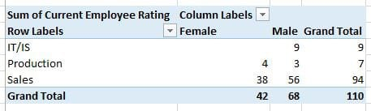
RESULTS
1.TABLE
12

Slide 13
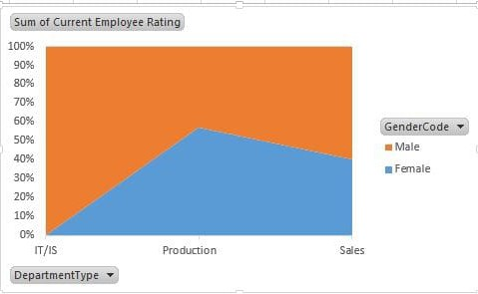
2. AERA DIAGRAM

Slide 14
conclusion
The dataset reveals the overall composition of the workforce, including demographics such as gender. salary, employee type and work location This information is crucial for understanding the diversity and experience level within the organization. The analysis aids in workforce planning by forecasting future staffing needs based on current trends and organizational growth projections.

